Slide 1
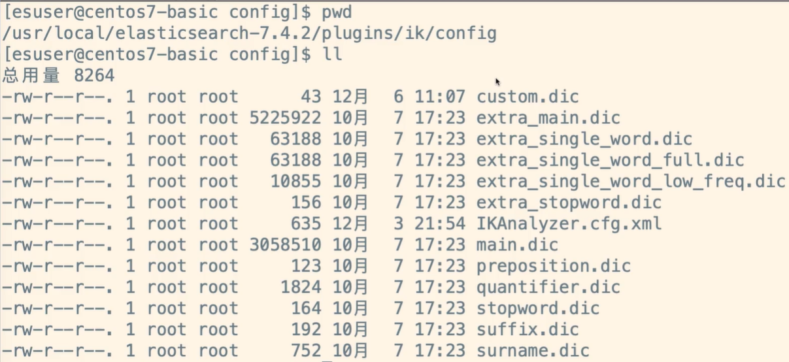
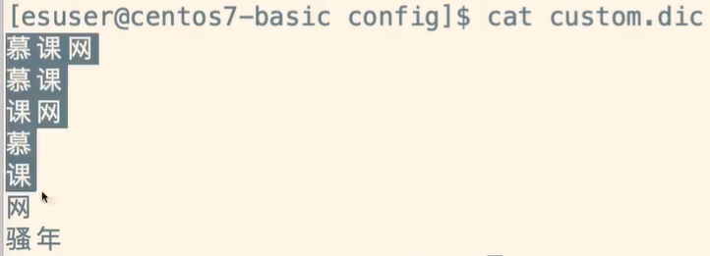
修改自定义词库

Slide 2
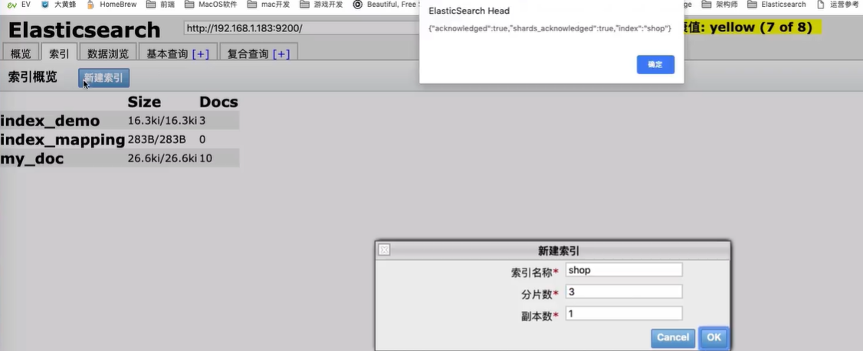
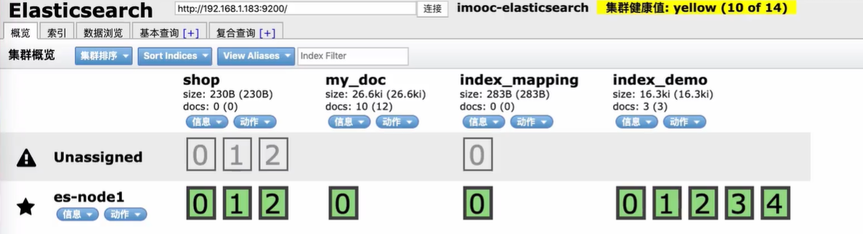
建立索引

Slide 3
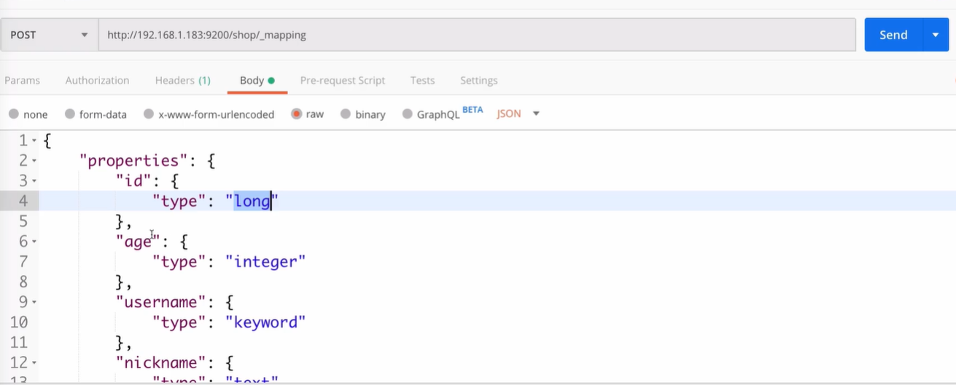
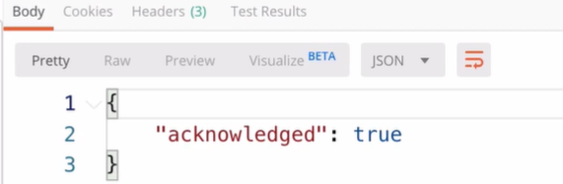
手动建立mappings
POST /shop/_mapping
{
"properties": {
"id": {
"type": "long"
},
"age": {
"type": "integer"
},
"username": {
"type": "keyword"
},
"nickname": {
"type": "text",
"analyzer": "ik_max_word"
},
"money": {
"type": "float"
},
"desc": {
"type": "text",
"analyzer": "ik_max_word"
},
"sex": {
"type": "byte"
},
"birthday": {
"type": "date"
},
"face": {
"type": "text",
"index": false
}
}
}

Slide 4
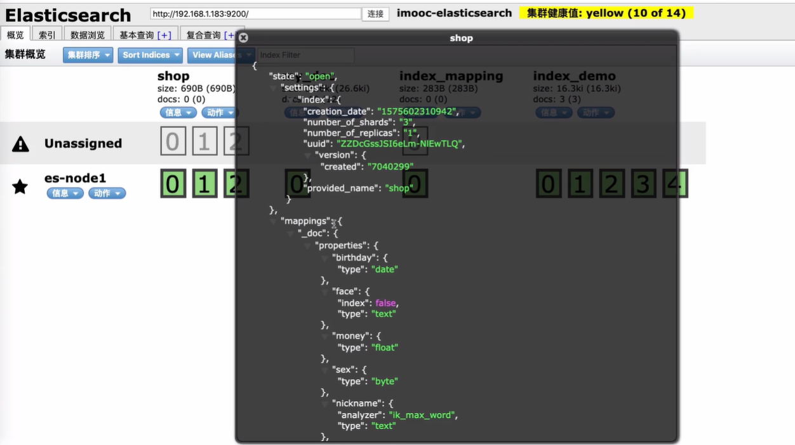
mappings建立成功

Slide 5
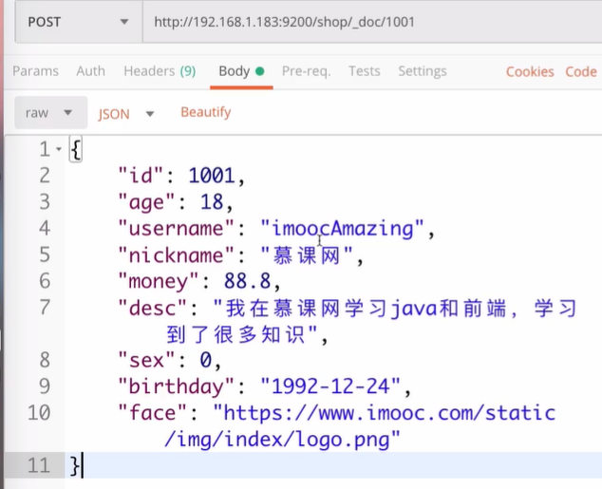
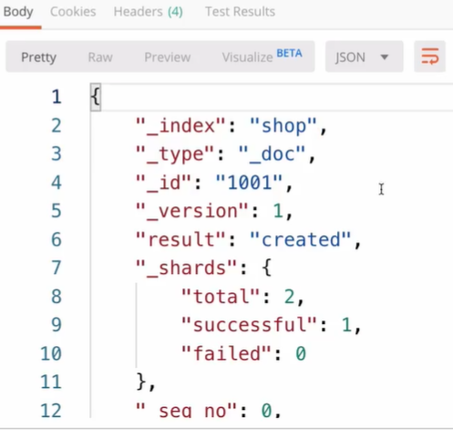
录入数据
POST /shop/_doc/1001
{
"id": 1001,
"age": 18,
"username": "imoocAmazing",
"nickname": "慕课网",
"money": 88.8,
"desc": "我在慕课网学习java和前端，学习到了很多知识",
"sex": 0,
"birthday": "1992-12-24",
"face": "https://www.imooc.com/static/img/index/logo.png"
}
{
"id": 1002,
"age": 19,
"username": "justbuy",
"nickname": "周杰棍",
"money": 77.8,
"desc": "今天上下班都很堵，车流量很大",
"sex": 1,
"birthday": "1993-01-24",
"face": "https://www.imooc.com/static/img/index/logo.png"
}
…
{
"id": 1012,
"age": 31,
"username": "super hero",
"nickname": "super hero",
"money": 188.8,
"desc": "BatMan, GreenArrow, SpiderMan, IronMan... are all Super Hero",
"sex": 1,
"birthday": "1980-08-14",
"face": "https://www.imooc.com/static/img/index/logo.png"
}

Slide 6
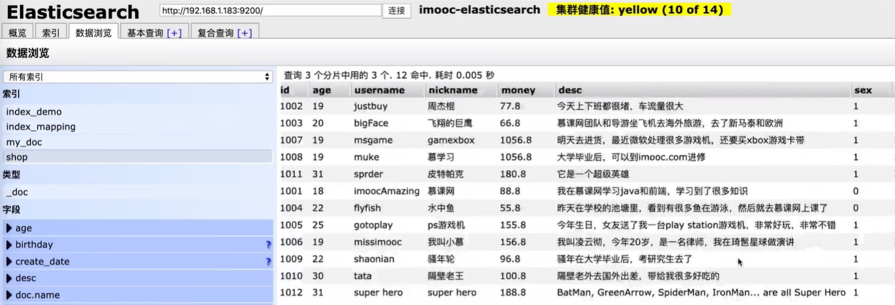
录入数据成功

